Slide 1
Heart Disease Prediction
By: Anthony Ciero and Varun Doddapaneni

Slide 2
Project Motivation
Heart disease can be caused by a number of factors.
We want to be able to allow doctors to inform patients when they may be at a potential risk for heart disease.
Process patient data and train multiple classification models to predict whether a patient is at risk based on training data that we give to the models.
Acquire an accuracy score of how well the model predicts whether a test patient has or doesn't have a heart disease.

Slide 3
Data Collection/Processing/Standardization
Features:
Age
Sex (0 = female 1 = male)
Chest pain type 0-3
Resting blood pressure in mmHg
Serum cholesterol in mg/dl
Fasting blood sugar > 120 mg/dl (T/F)
Resting electrocardiographic results 0-2
Maximum heart rate
Exercise induced angina (T/F)
ST depression induced by exercise relative to rest
Slope of the peak exercise ST segment
Number of major vessels colored by fluoroscopy 0-3
Thal (1 is normal, 2 is fixed defect, and 3 is reversible defect)
Target: Heart Disease (T/F)
*True or false represented by 0 and 1
Train/Validation/Test Split (60/20/20)
Standardization using StandardScaler

Slide 4
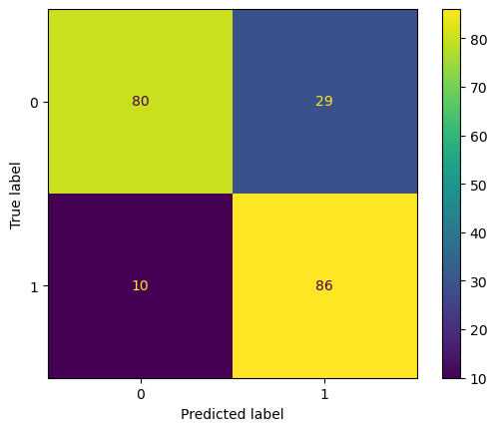
Baseline Model (LogisticRegression)
Fit model using scaledTrainX, trainY
Get train, validation, test predictions
Use these for find accuracy scores
Test accuracy ~0.81
Print predicted vs true class labels to see which it properly and improperly predicted
Classification Report
Precision: ability to not label negative samples as positive
Recall: ratio of correctly predicted samples vs all samples of that class
F1: harmonic mean of precision and recall
Support: the number of actual occurrences of the class
Confusion Matrix shows true and false positives and negatives

Slide 5
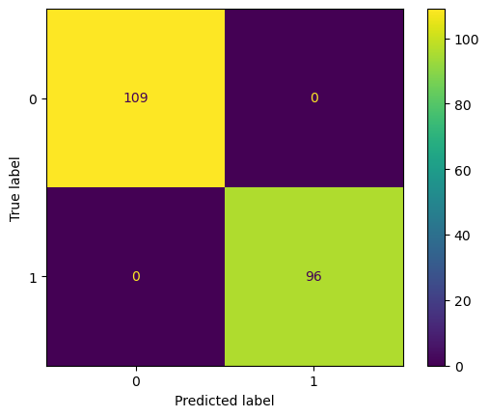
Linear Basis Function
Best Degree: 3
Best C Value: 1
Best Validation Accuracy: 1.0
Final Test Accuracy: 1.0
Hyperparameters for LogisticRegression Model
Polynomial Degree: (1, 2, 3) PolynomialFeatures
Regularization Parameters: C Values (0.01, 0.1, 1 (standard) 10)
Track which model gives the best validation accuracy, save the best degree, C value, model, and polynomial features
Create PolynomialFeatures model using the degrees
Fit and transform training and validation Poly to get polynomial and interaction features
Create model using C values and fit it using the trainingPoly
Predict using validationPoly and find validation accuracy
Print the hyperparameters and accuracy, only save features if new validation accuracy is better than the previous model
Transform using best polynomial and use the best model to find the test prediction and accuracy
Predicted vs True Labels, Classification Report, Confusion Matrix

Slide 6
Kernel Ridge Regression
Best Kernel: rbf
Best Alpha: 0.1
Best Validation Accuracy: ~0.985
Final Test Accuracy: 1.0
Hyperparameters for KernelRidge Model
Kernel Type: (linear, rbf, poly)
Regularization Parameters: Alpha (0.01, 0.1, 1, 10)
Track which model gives the best validation accuracy, save the alpha, kernel, and model
Create the KernelRidge model and fit it using the scaledTrainX, trainY
Get the validation prediction by predicting the model and converting values less than 0.5 to class 0 and greater than to class 1
Print the hyperparameters and accuracy, only save features if new validation accuracy is better than the previous model
Predict test prediction and find the test accuracy
Predicted vs True Labels, Classification Report, Confusion Matrix

Slide 7
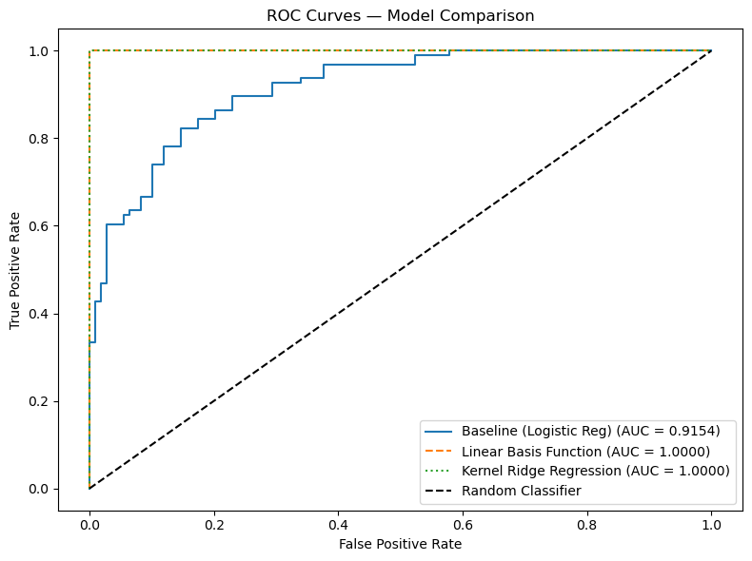
Model Comparison
Best Kernel: rbf
Best Alpha: 0.1
Best Validation Accuracy: ~0.985
Final Test Accuracy: 1.0
Compare 3 chosen models using accuracy, F1-score, and Receiver Operating Characteristic – Area Under the Curve (ROC-AUC)
Get predictions and probabilities of positive for heart disease for each model
Find and print accuracy, F1 score and ROC-AUC for each model
Model Accuracy F1 Score ROC-AUC
---------------------------------------------------------------
Baseline (Logistic Reg) 0.8098 0.8152 0.9154
Linear Basis Function 1.0000 1.0000 1.0000
Kernel Ridge Regression 1.0000 1.0000 1.0000
Find the false and true positive rate (FPR/TPR) and AUC so we can plot the ROC Curves for each model

Slide 8
Conclusion
Baseline model accuracy was good but in a potentially life-threatening situation like heart disease, this just isn't close enough.
With 2 different models, we can train it to be more accurate by choosing specific hyperparameters.
Testing is important, as some models/hyperparameters yield a lower validation accuracy than our baseline model.
Both models with specified hyperparameters are able to correctly predict if a patient has a heart disease 100% of the time (certain features may be extremely predictive of the label).
Possible signs of overfitting with perfect accuracy due to small sample size
While all features are important, allows medical professionals to more accurately predict potential disease, allowing them to warn a patient at risk before disaster strikes using this new model tuning.

